Slide 1
Introduction to Deep Learning
Hongtu Zhu
The University of North Carolina at Chapel Hill
June 15, 2024

Slide 2
Content
1 Applications of deep learning
2 Deep learning basics
3 Deep learning model structures
4 Training deep learning models
5 Deep learning theory

Slide 3
Deep Learning
Deep
Learning
Many hidden layers
Supervised, semi-supervised, unsupervised
Learn adaptive parameters
Use a cascade of multiple layers of nonlinear processing units for feature extract and transformation
Learn in supervised and/or unsupervised manner
Learn representations in different level of abstraction
Why popular?
Chip processing ability
Increased size of data for training
Advances in machine learning and
signal/information researches
Deep models to efficiently exploit
complex, compositional nonlinear functions
to learn distributed and hierarchical feature
representations, to make best use of the data.

Slide 4
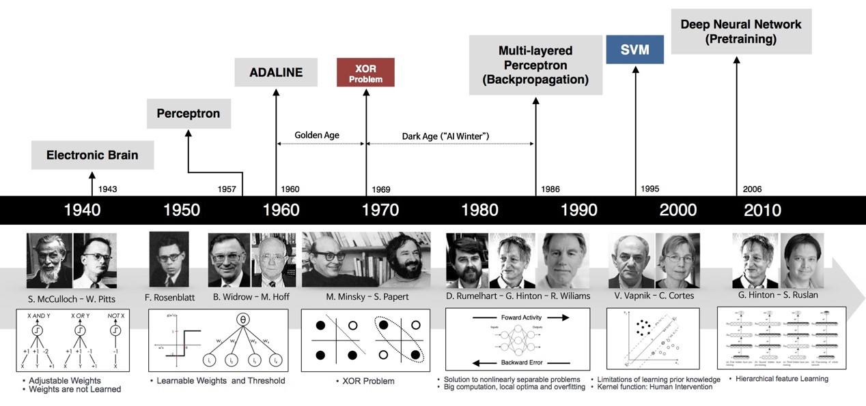
Historical Summary

Slide 5









Deep learn platforms

Slide 6
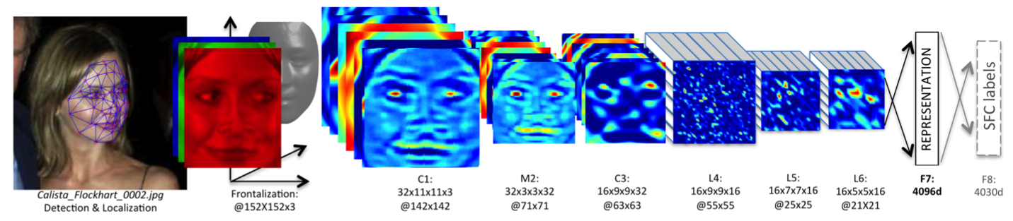
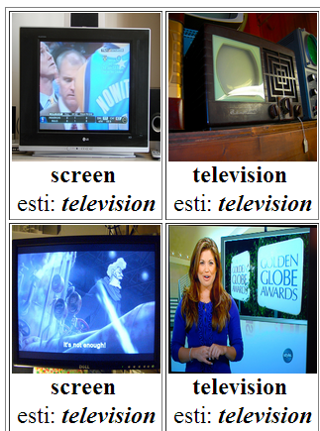
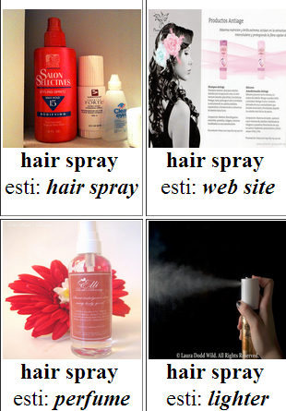

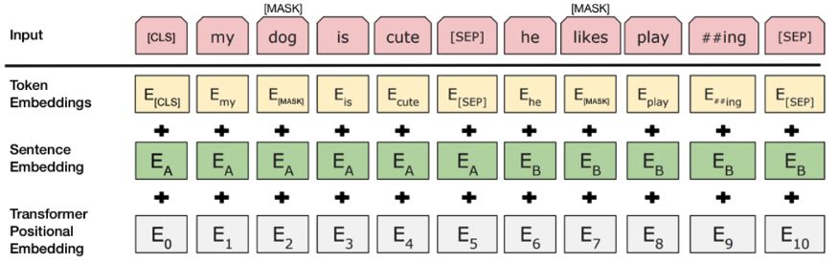
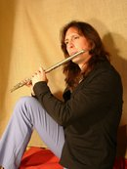
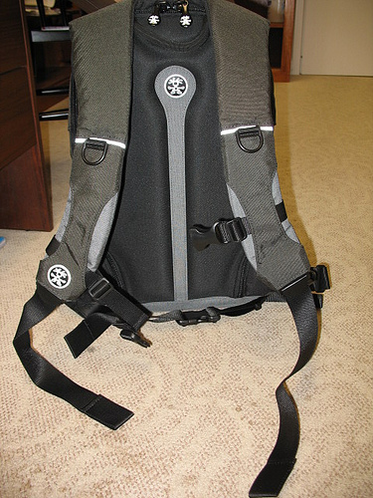
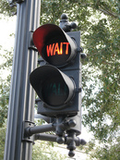
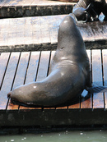

Applications - Vision

Slide 7
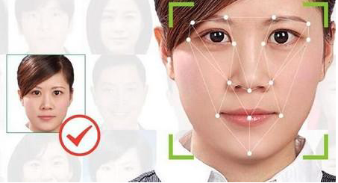
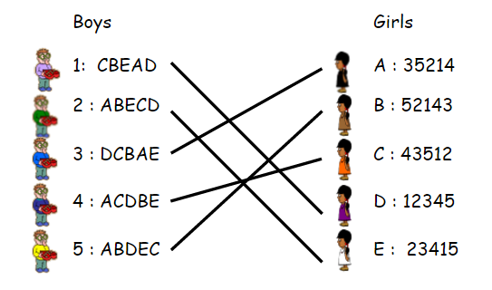
Applications - Vision

Slide 8
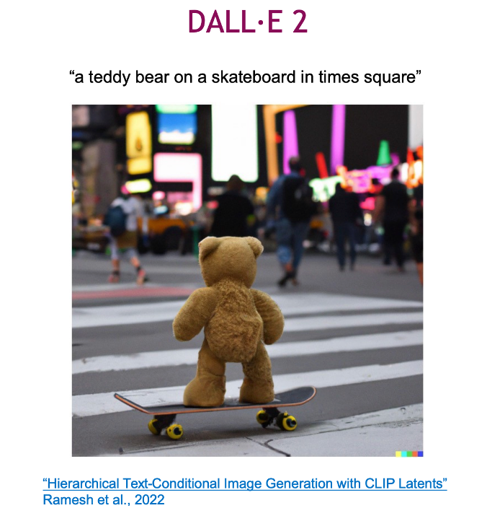
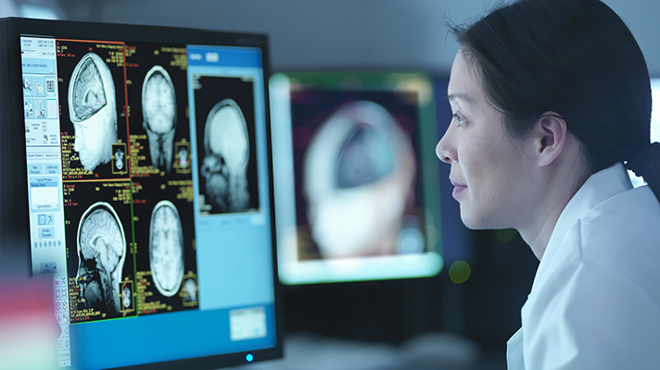
Applications - Vision
High quality image generalization
Disease Detection in Healthcare and Medicine
Deep learning can be utilized for early and more accurate detection of diseases like cancer, Alzheimer's, and heart diseases through image analysis.

Slide 9
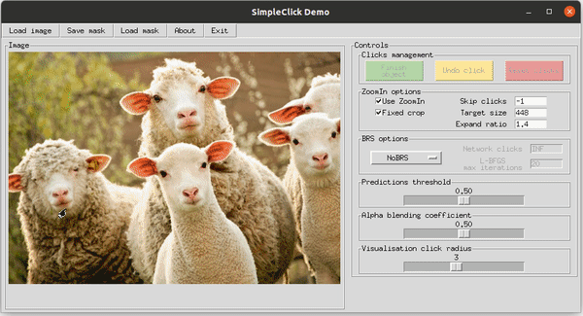
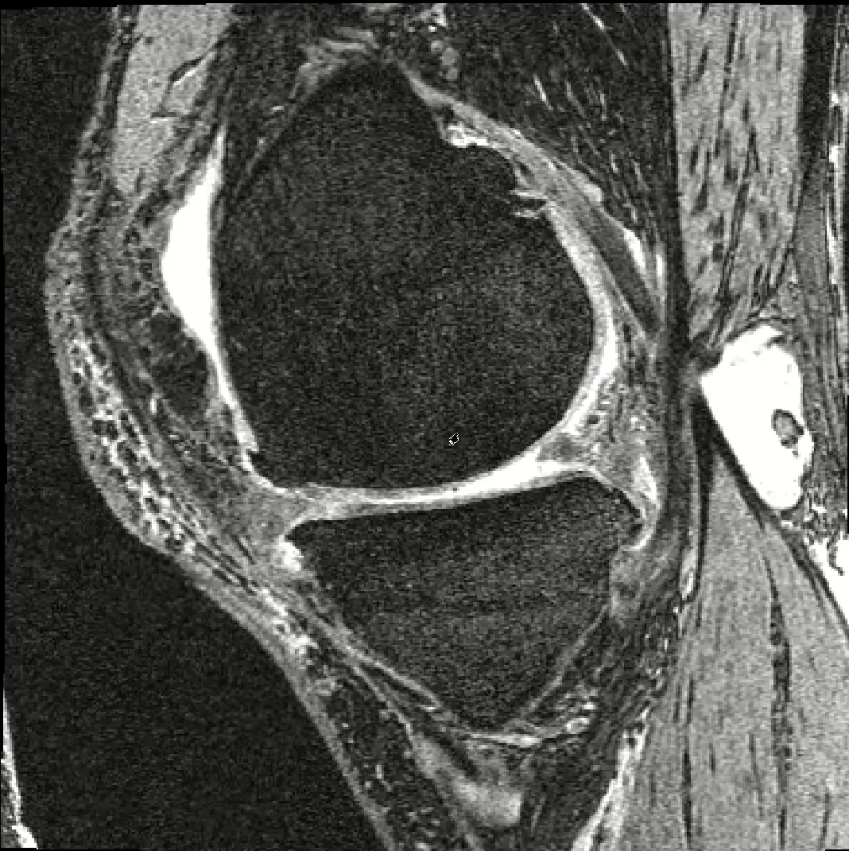
Applications – Medical Imaging
Segmentation Annotation
U-Nets
Liu, Q., Xu, Z., Bertasius, G., & Niethammer, M. (2023). SimpleClick:
Interactive Image Segmentation with Simple Vision Transformers. ICCV., 22290-22300. 2023.
Azad et al., “Medical Image Segmentation Review: The success of U-Net.” arXiv, Nov. 27, 2022.
Minaee, Shervin, et al. "Image segmentation using deep learning: A survey." IEEE PAMI 44.7 (2021): 3523-3542.

Slide 10
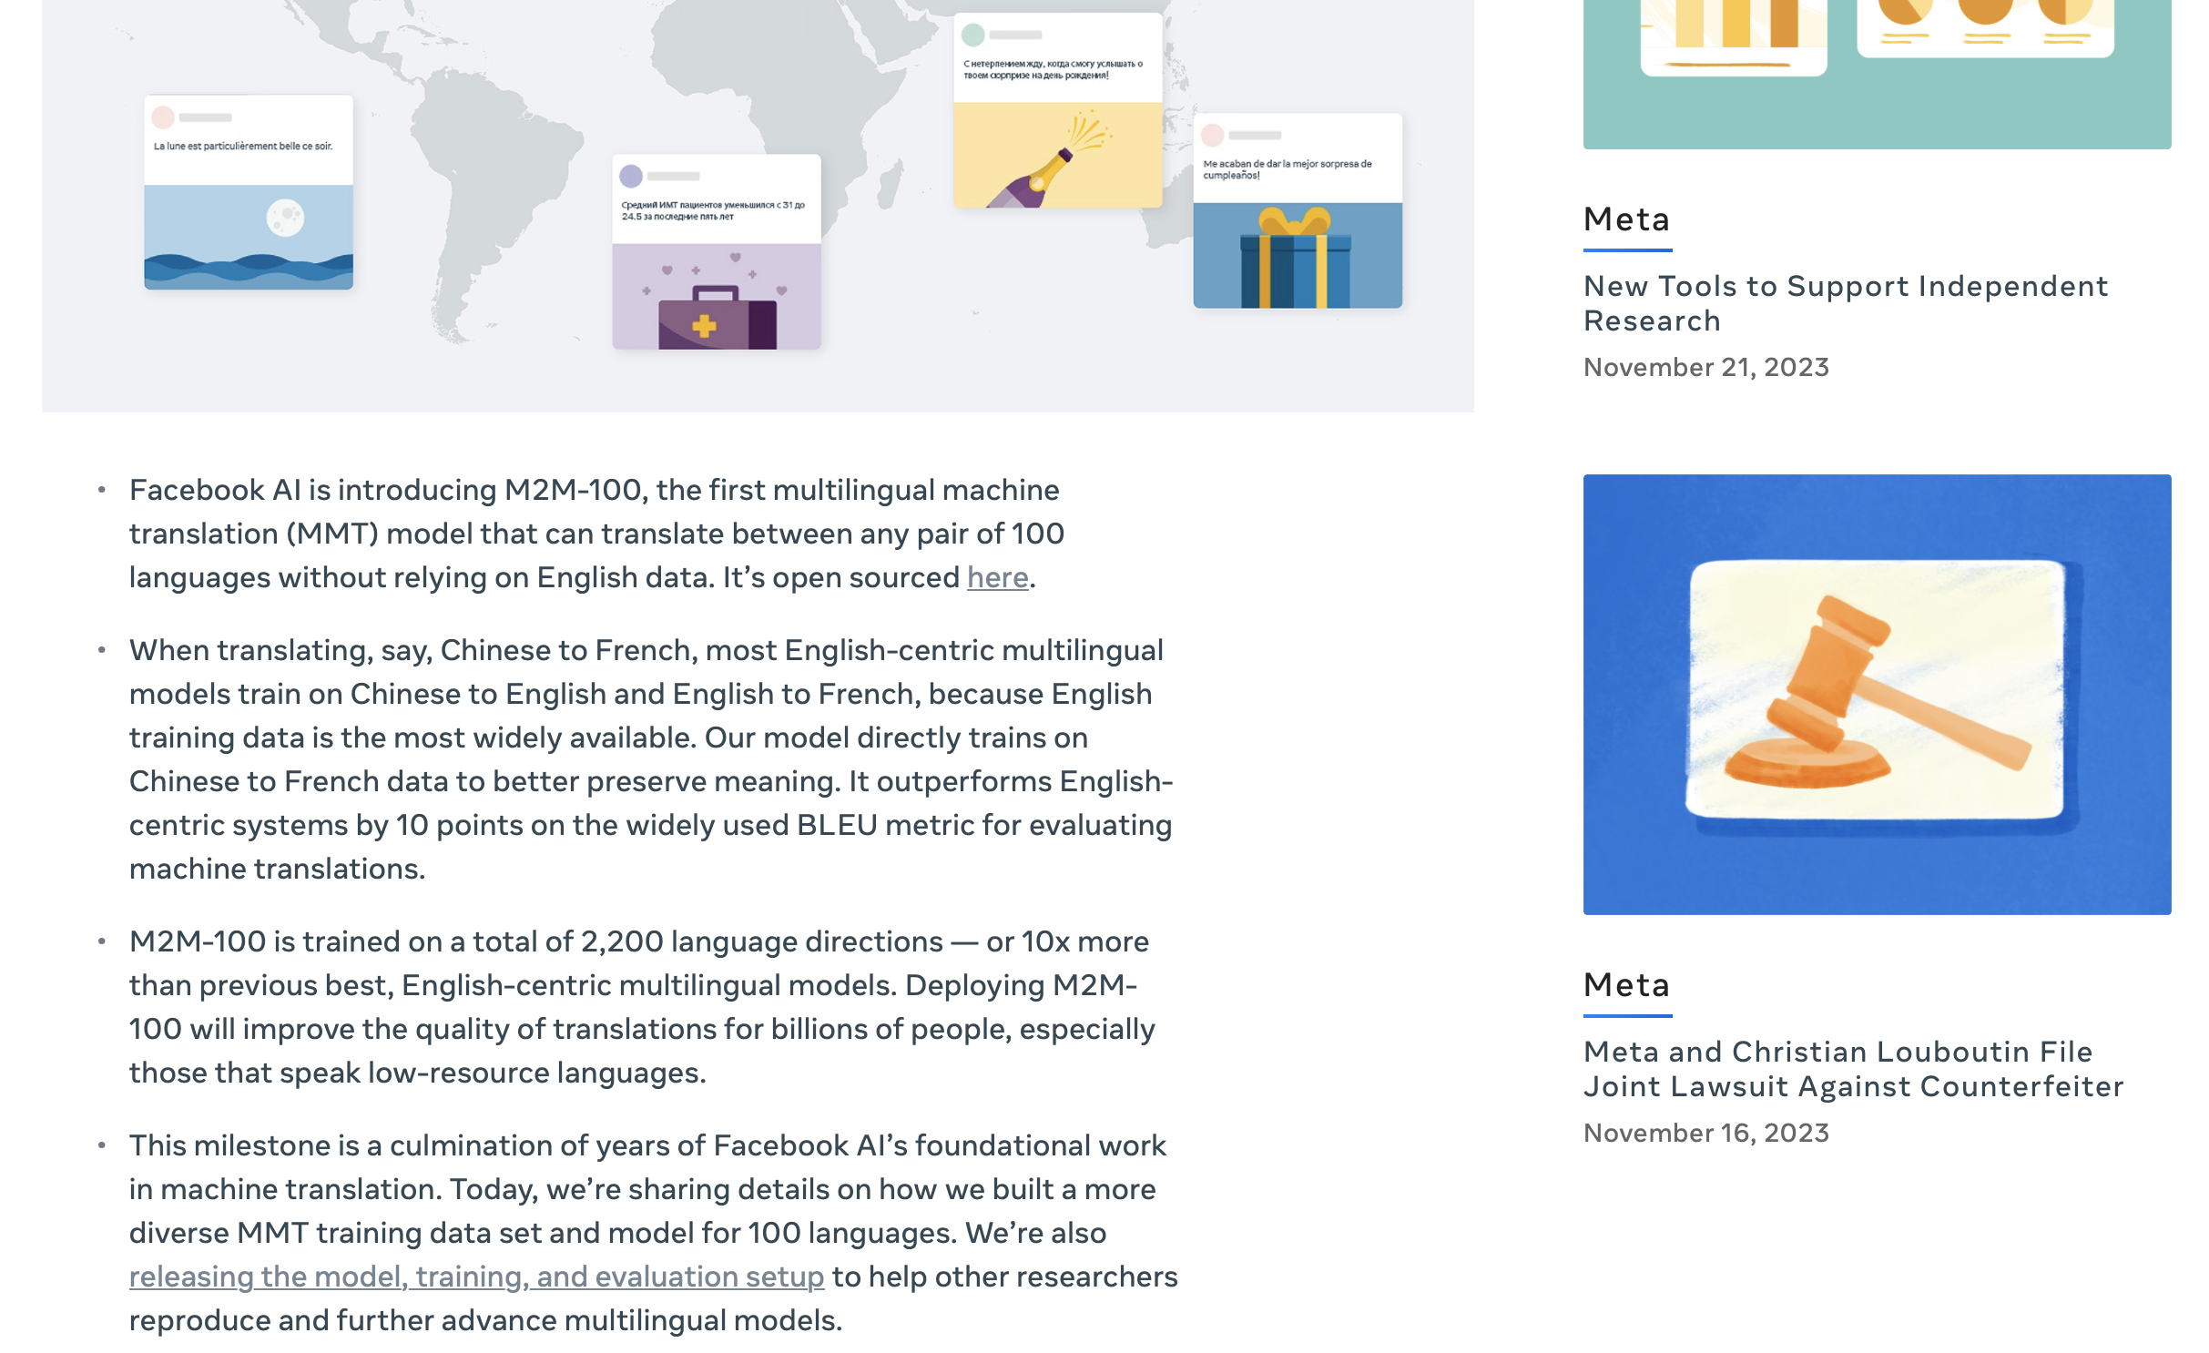

Application - Language
Language Translation in Natural Language Processing
Deep learning enhances real-time, accurate translation of languages, as seen in tools like Google Translate. The following picture shows the translation of a webpage from English to Chinese.

Slide 11
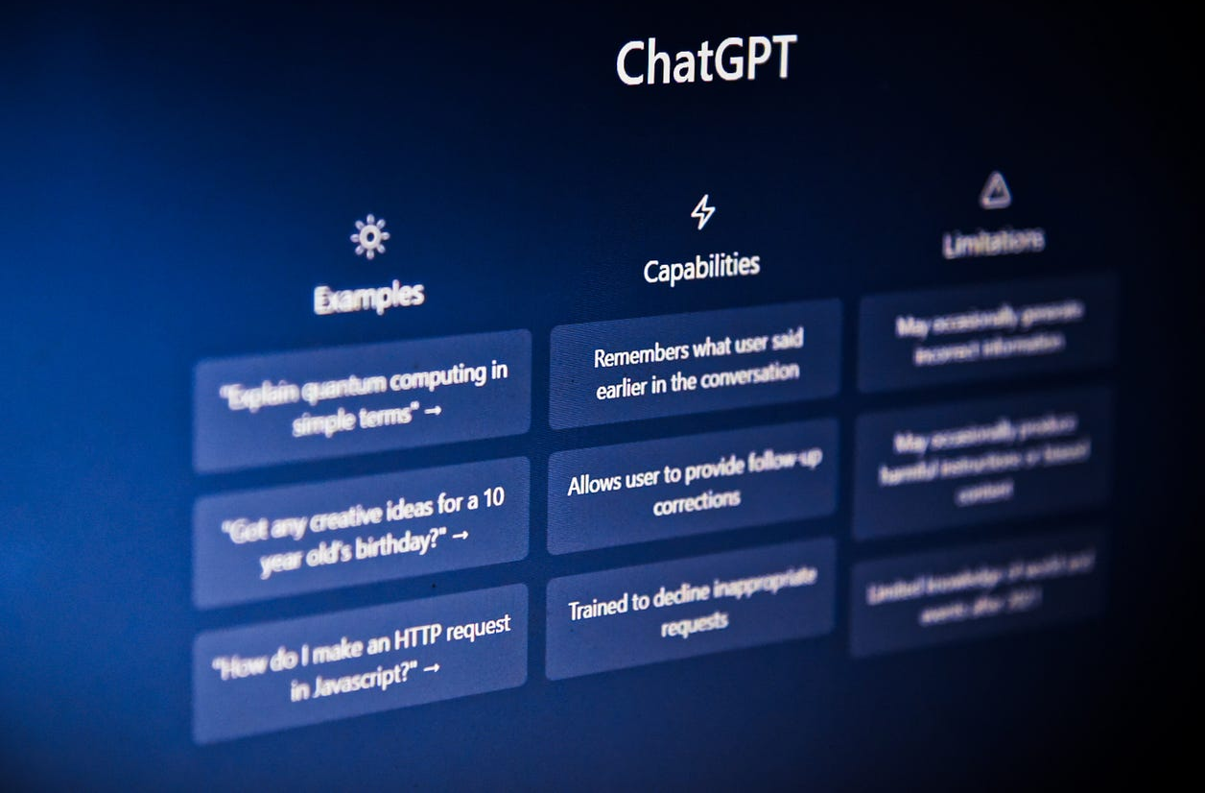
Application - Language
Large language models
Large language models can perform various tasks such as answering questions, generating creative content, summarizing text, translating languages, and engaging in conversations. It’s designed to understand and generate text in a coherent and contextually relevant manner.

Slide 12
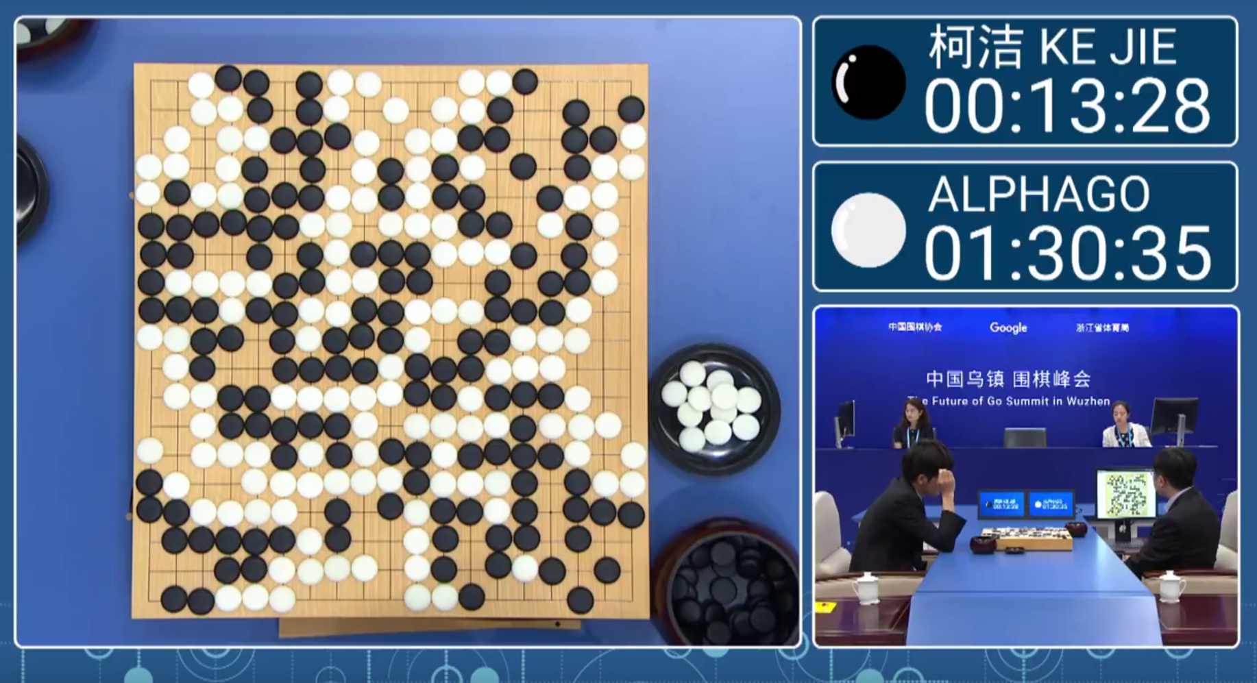
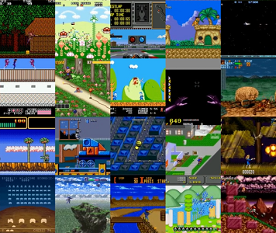
Application - Decision
March 2016, AlphaGo made headlines by defeating Lee Sedol.
Reinforcement learning methods have shown priority in video games.

Slide 13

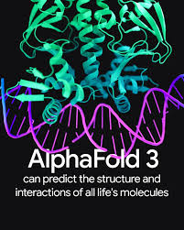
Application - more
Personalized Shopping Experience in Retail and E-Commerce
Predict the folding and 3D structure of protein
Deep learning is leveraged to provide personalized recommendations and targeted advertising to customers based on their shopping behavior.
AlphaFold aims to solve the protein folding problem, which involves predicting a protein's three-dimensional structure based solely on its amino acid sequence. Understanding protein structures is crucial for biological research and drug discovery.

Slide 14

What Exactly is Deep Learning?

Slide 15
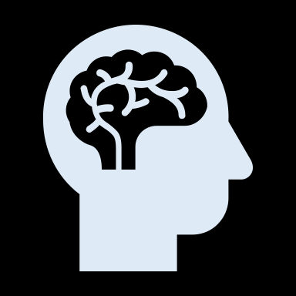






Key Terminologies
Artificial Intelligence
Simulates human intelligence in machines for tasks like decision-making and language translation.
Machine Learning (ML)
A subset of AI where algorithms learn from data to make predictions or decisions without being explicitly programmed for each scenario.
Deep Learning (DL)
A branch of machine learning using multi-layered neural networks, effective in processing large amounts of unstructured data like images and speech.
Generative AI
AI algorithms that generate new, original content (like text or images) based on existing data, using techniques like Generative Adversarial Networks (GANs).

Slide 16
Deep Learning
Deep learning is a subset of machine learning that focuses on training artificial neural networks to perform tasks. Its algorithms were inspired by the working of the human brain.
It‘s characterized by the use of multiple layers (deep architectures) that allow networks (neural networks) to learn hierarchical representations of data and to learn to complete specific tasks.
In contrast to traditional machine learning, which often requires manual feature extraction, deep learning can automatically learn features from raw data, which you can think of as patterns that occur within the data.
Deep learning can be used for supervised, unsupervised as well as reinforcement machine learning.
Objective: teaching computer how to learn a task directly from raw data
Notes:
https://www.youtube.com/watch?v=QDX-1M5Nj7s&list=PLtBw6njQRU-rwp5__7C0oIVt26ZgjG9NI

Slide 17
Content
1 Applications of deep learning
2 Deep learning basics
3 Deep learning model structures
4 Fitting deep learning models
5 Deep learning theory

Slide 18
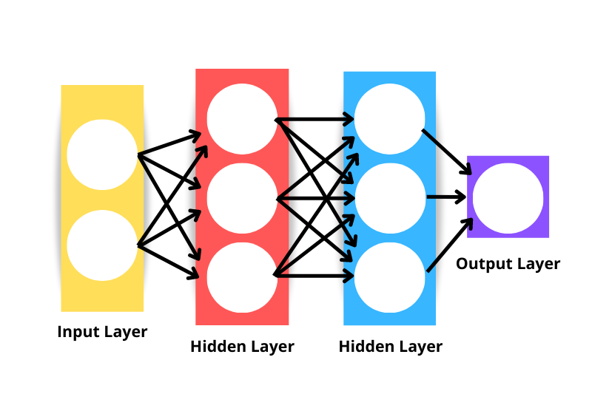
Backbone of Deep Learning - Neural Networks
Neural networks, also called artificial neural networks (ANNs) or simulated neural networks (SNNs), are a subset of machine learning and are the backbone of deep learning algorithms.
The neural network is inspired by the human brain’s interconnected neurons. They are called “neural” because they mimic how neurons in the brain signal one another.
It consists of layers: an input layer, one or more hidden layers, and an output layer.
The “deep” in deep learning refers to the depth of layers in a neural network.
Usually, a neural network of more than three layers, including the inputs and the output, can be considered a deep-learning algorithm.
Further details on neural networks will be in upcoming courses.
Notes:
https://www.ibm.com/blog/ai-vs-machine-learning-vs-deep-learning-vs-neural-networks/#
Figure from: https://www.datacamp.com/tutorial/pytorch-tutorial-building-a-simple-neural-network-from-scratch

Slide 19
Deep Learning Basics
Neurons (Nodes) receive input signals and perform computations and produce an output.
Channels (connections) are associated with a weight value that determines the strength of the connection.
Bias is conceptually similar to the intercept in linear regression, accounting for potential deviations from the ideal relationship between inputs and outputs.
Activation function are threshold values that introduce non-linearities into the neural network, determining if the particular neuron will get activated or not.

Slide 20
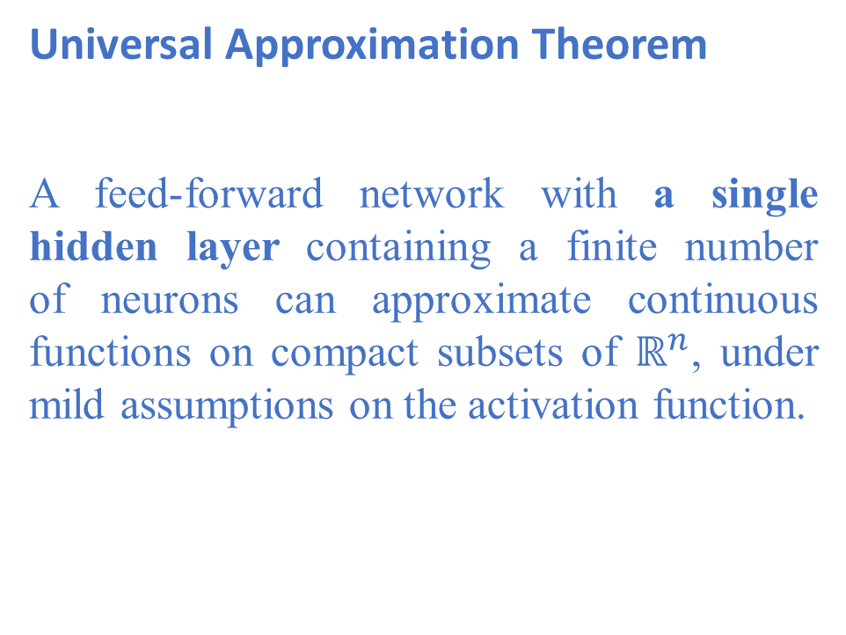
Shallow Neural Network
Universal Approximation Theorem
A feed-forward network with a single hidden layer containing a finite number of neurons can approximate continuous functions on compact subsets of $ℝ^{n}$, under mild assumptions on the activation function.
Cybenko (1989) and Hornik (1991)

Slide 21
Activation Functions
Logistic sigmoid and tanh functions.
Leaky ReLU and parametric ReLU with parameter 0.25.
SoftPlus, Gaussian error linear unit, and sigmoid linear unit.
Exponential linear unit with parameters 0.5 and 1.0.
Scaled exponential linear unit.
Swish with parameters 0.4, 1.0, and 1.4.

Slide 22
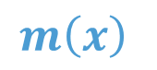
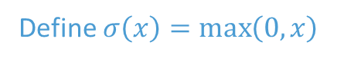
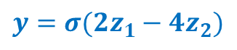
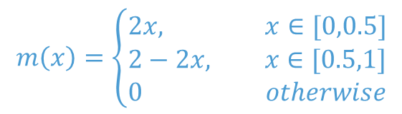
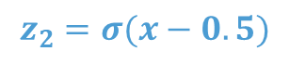
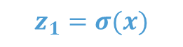

Motivation for Deep Learning
$$m\left(x\right)=\left\{\begin{aligned}2x, x∈[0,0.5] \\ &2−2x, x∈[0.5,1] \\ \begin{matrix}0 & otherwise\end{matrix}\end{aligned}\right.$$
Consider a piecewise linear function
Define $σ\left(x\right)=\max\left(0,x\right)$
$$m\left(x\right)$$
$${y=σ(2z}_{1}−4z_{2})$$
1
$$z_{1}=σ(x)$$
$$z_{2}=σ(x−0.5)$$
0.5
$$x$$

Slide 23
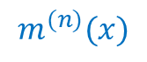
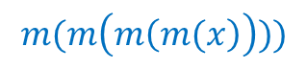
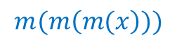

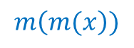
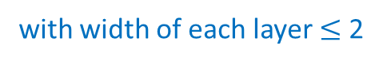
Motivation for Deep Learning
$$m\left(m(x\right))$$
$$m(m\left(m(x\right)))$$
$$m(m\left(m\left(m(x\right)\right)))$$
Depth
- Multiplicatively
Generate a deep network:
3n+1 nodes to represent the
$$m^{(n)}(x)$$
with width of each layer $≤$ 2
Width
- additively
If we generate a shallow one, we need$2^{n}$ nodes.

Slide 24
Deep Neural Network
Shallow vs deep networks
both networks can approximate any function given enough capacity,
deep networks produce many more linear regions per parameter,
some functions can be approximated much more
efficiently by deep networks,
in practice, the best results for most tasks are achieved using deep networks with many layers.
The number of hidden units in each layer is referred to as the width of the network, and the number of hidden layers as the depth. The total number of hidden units is a measure of the network’s capacity.
The depth version of the universal approximation theorem (Lu et al., 2017): There exists a network with ReLU activation functions and at least Di +4 hidden units in each layer can approximate any specified Di-dimensional Lebesgue integrable function to arbitrary accuracy given enough layers.

Slide 25
Fitting DL Models
AS=Applied Statistics
AS=Applied Statistics
Design the neural network
Define a set of functions/models
Find a criterion/measurement of goodness –
loss( + regularization)
Get the best model for the problem
Define a set of functions/models
Find a criterion/measurement of goodness –
loss( + regularization)
Get the best model for the problem

Slide 26



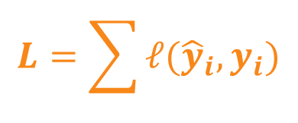






Fitting DL Models
Design the neural network
Find a criterion/measurement of goodness
Get the best model for the problem
$$X_{1}$$
$${\hat{y}}_{1}$$
$$y_{1}$$
Designed
Neural Network
$$X_{2}$$
$${\hat{y}}_{2}$$
$$y_{2}$$
……
……
……
$$X_{n}$$
$${\hat{y}}_{n}$$
$$y_{n}$$
A loss function is needed here,
to measure the difference between the output and truth
Total loss:
$$L=\sum{ℓ({\hat{y}}_{i},y_{i})}$$

Slide 27
Content
1 Applications of deep learning
2 Deep learning basics
3 Deep learning model architectures
4 Training deep learning models
5 Deep learning theory

Slide 28

Modern DL Model Architectures
1
Convolutional Neural Networks (CNNs)
Key Features: Utilizes convolutional layers to process data in a grid pattern (like images).
Key Components:
Convolutional Layers: Extract features from input images using filters.
Pooling Layers: Reduce dimensions and computational load, retaining key information.
Fully Connected Layers: Classify images based on extracted features.
Example Models: LeNet-5, AlexNet, VGGNet.
Figure. Basic CNN structure.
Applications in Biomedicine:
Image classification in diagnostics (e.g., cancer detection from scans).
Image segmentation for identifying regions of interest in medical images.
Notes:
Ref: https://www.upgrad.com/blog/basic-cnn-architecture/
https://medium.com/techiepedia/binary-image-classifier-cnn-using-tensorflow-a3f5d6746697

Slide 29
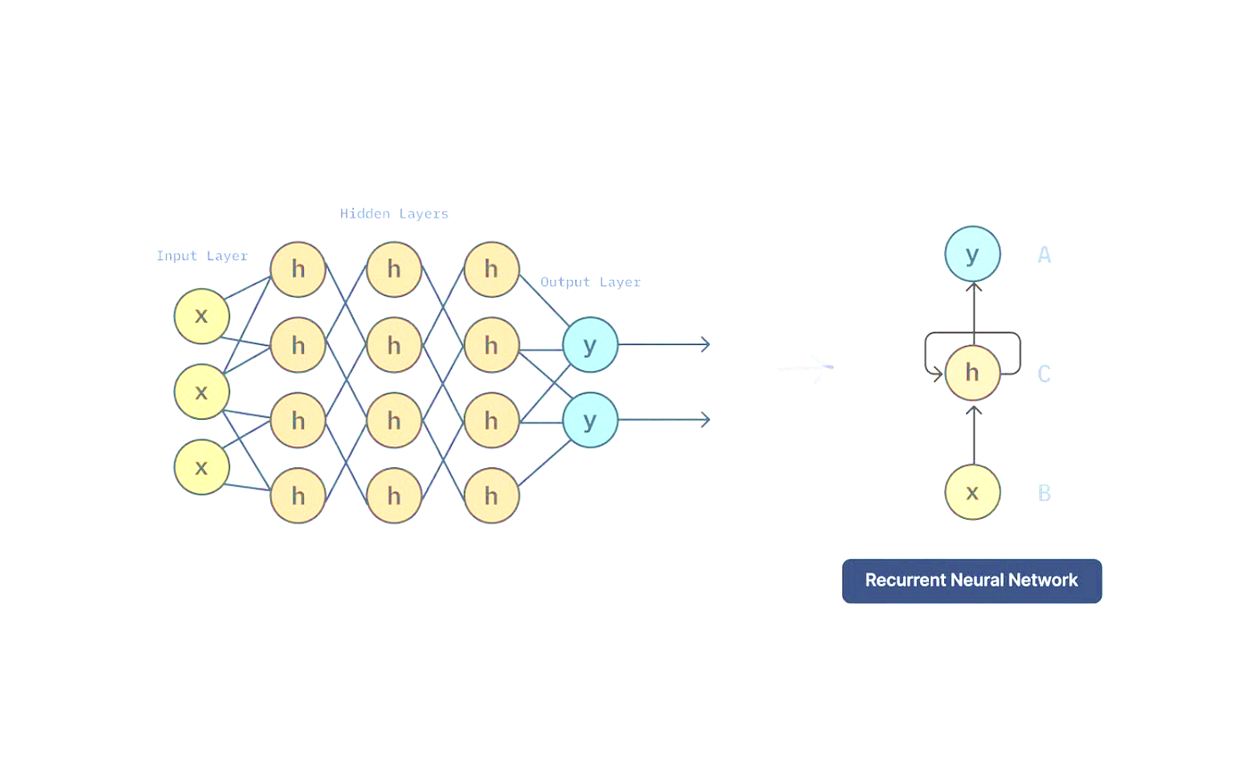
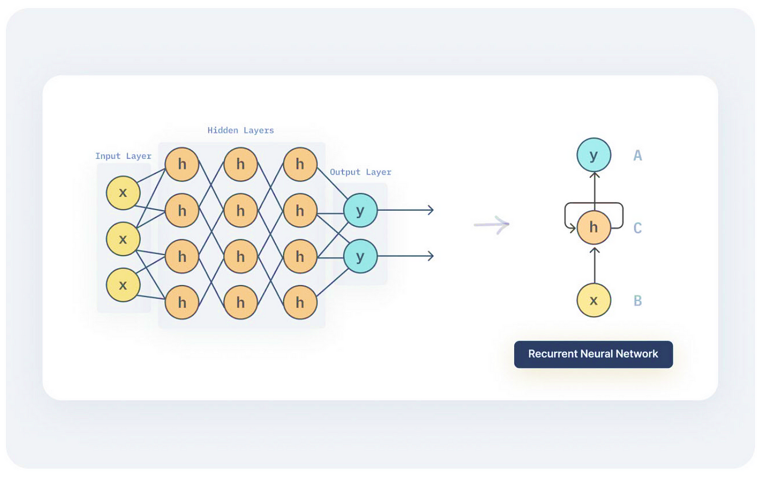

Modern DL Model Architectures
2
Recurrent Neural Networks (RNNs)
Key Features: Processes sequences of data (time-series data), with memory of previous inputs, capturing temporal dynamics.
Unique Feature: Loop-like architecture allowing previous outputs to be used as inputs while having hidden states, enabling information persistence.
Challenges & Solutions: Problem of vanishing gradients; solved by advanced RNNs, e.g. LSTM and GRU.
Example Models: LSTM (Long Short-Term Memory), GRU (Gated Recurrent Unit).
Applications in Biomedicine:
Analysis of sequential patient data in EHRs.
Time-series analysis in physiological signal processing.
Notes:
Ref: https://stanford.edu/~shervine/teaching/cs-230/cheatsheet-recurrent-neural-networks
https://www.analyticsvidhya.com/blog/2022/03/a-brief-overview-of-recurrent-neural-networks-rnn/

Slide 30
Modern DL Model Architectures
3
U-Net
Key Features: U-shaped architecture with symmetric encoder and decoder paths. Skip connections that concatenate feature maps from encoder to decoder
Structure: Encoder: Series of convolutional and max-pooling layers that capture context. Bottleneck: Intermediate layer connecting encoder and decoder. Decoder: Series of up-convolution and concatenation layers that restore resolution. Final Layer: Convolutional layer that maps features to the desired output.
Types: 2D/3D U-Net, Attention U-Net.
U-Net for segmenting HeLa cells. The U-Net has an encoder-decoder structure, in which the representation is downsampled (orange blocks) and then re-upsampled (blue blocks). The encoder uses regular convolutions, and the decoder uses transposed convolutions. Residual connections append the last representation at each scale in the encoder to the first representation at the same scale
in the decoder (orange arrows).
Applications in Biomedicine: Medical image segmentation. Satellite image segmentation. Biomedical image analysis. Autonomous driving. General image segmentation tasks.
Notes:
Ref: https://towardsdatascience.com/applied-deep-learning-part-3-autoencoders-1c083af4d798

Slide 31
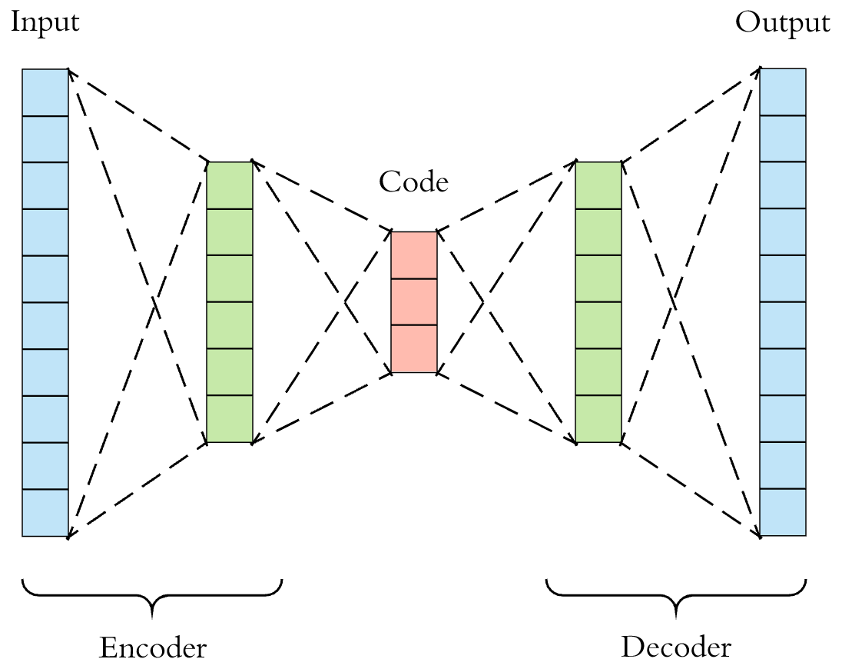
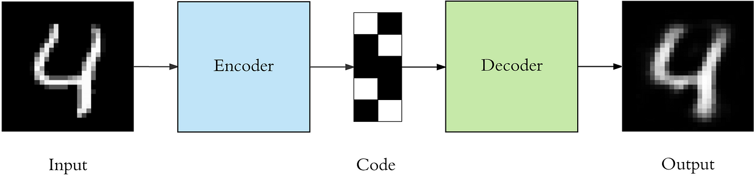
Modern DL Model Architectures
4
Autoencoders
Key Features: Unsupervised learning models for dimensionality reduction and feature learning.
Structure: Composed of an encoder (compressing input) and a decoder (reconstructing input).
Types: Standard Autoencoders, Variational Autoencoders (VAEs).
Applications in Biomedicine:
Data denoising (e.g., removing noise from images).
Anomaly detection in medical imaging (e.g., identifying unusual patterns).
Figure 1. Visualization of an autoencoder
Figure 2. Autoencoders are a specific type of feedforward neural networks where the input is the same as the output.
Notes:
Ref: https://towardsdatascience.com/applied-deep-learning-part-3-autoencoders-1c083af4d798

Slide 32
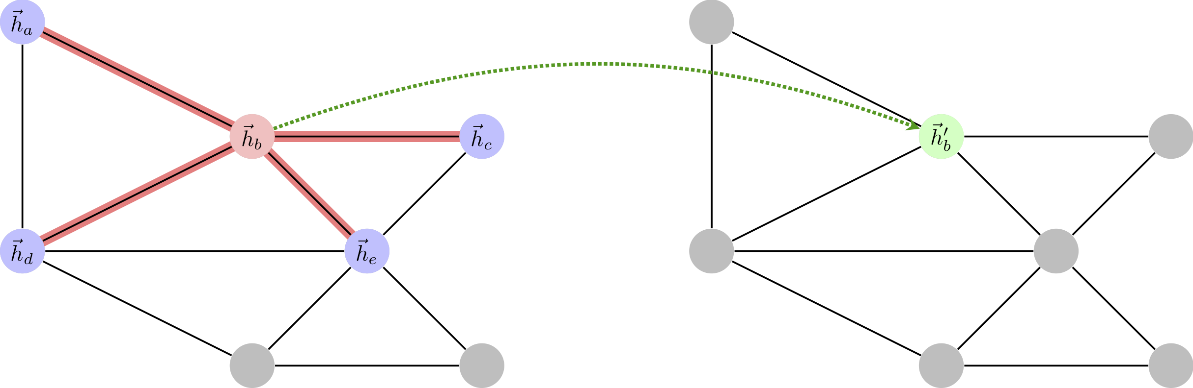
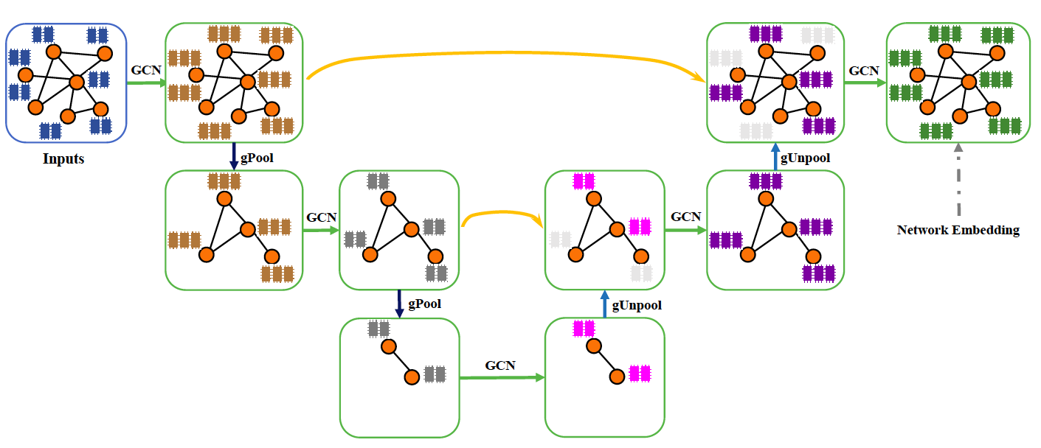
Modern DL Model Architectures
5
Graph Neural Network
Key Features: Ability to process graph-structured data. Utilizes node features and graph topology for learning. Effective in capturing dependencies between nodes. Supports inductive and transductive learning.
Structure: Nodes, Edges, Node Features, Graph Convolution, and Readout Layer.
Types: Graph Convolutional Networks (GCNs), Graph Attention Networks (GATs), Graph Recurrent Networks (GRNs), Graph Autoencoders, Graph U-Net
GNN
GAT
Applications in Biomedicine:
Social Network Analysis, Knowledge Graphs, Drug Discovery, Recommender Systems, Network Security
Graph U-Net
Notes:
Ref: https://towardsdatascience.com/applied-deep-learning-part-3-autoencoders-1c083af4d798

Slide 33
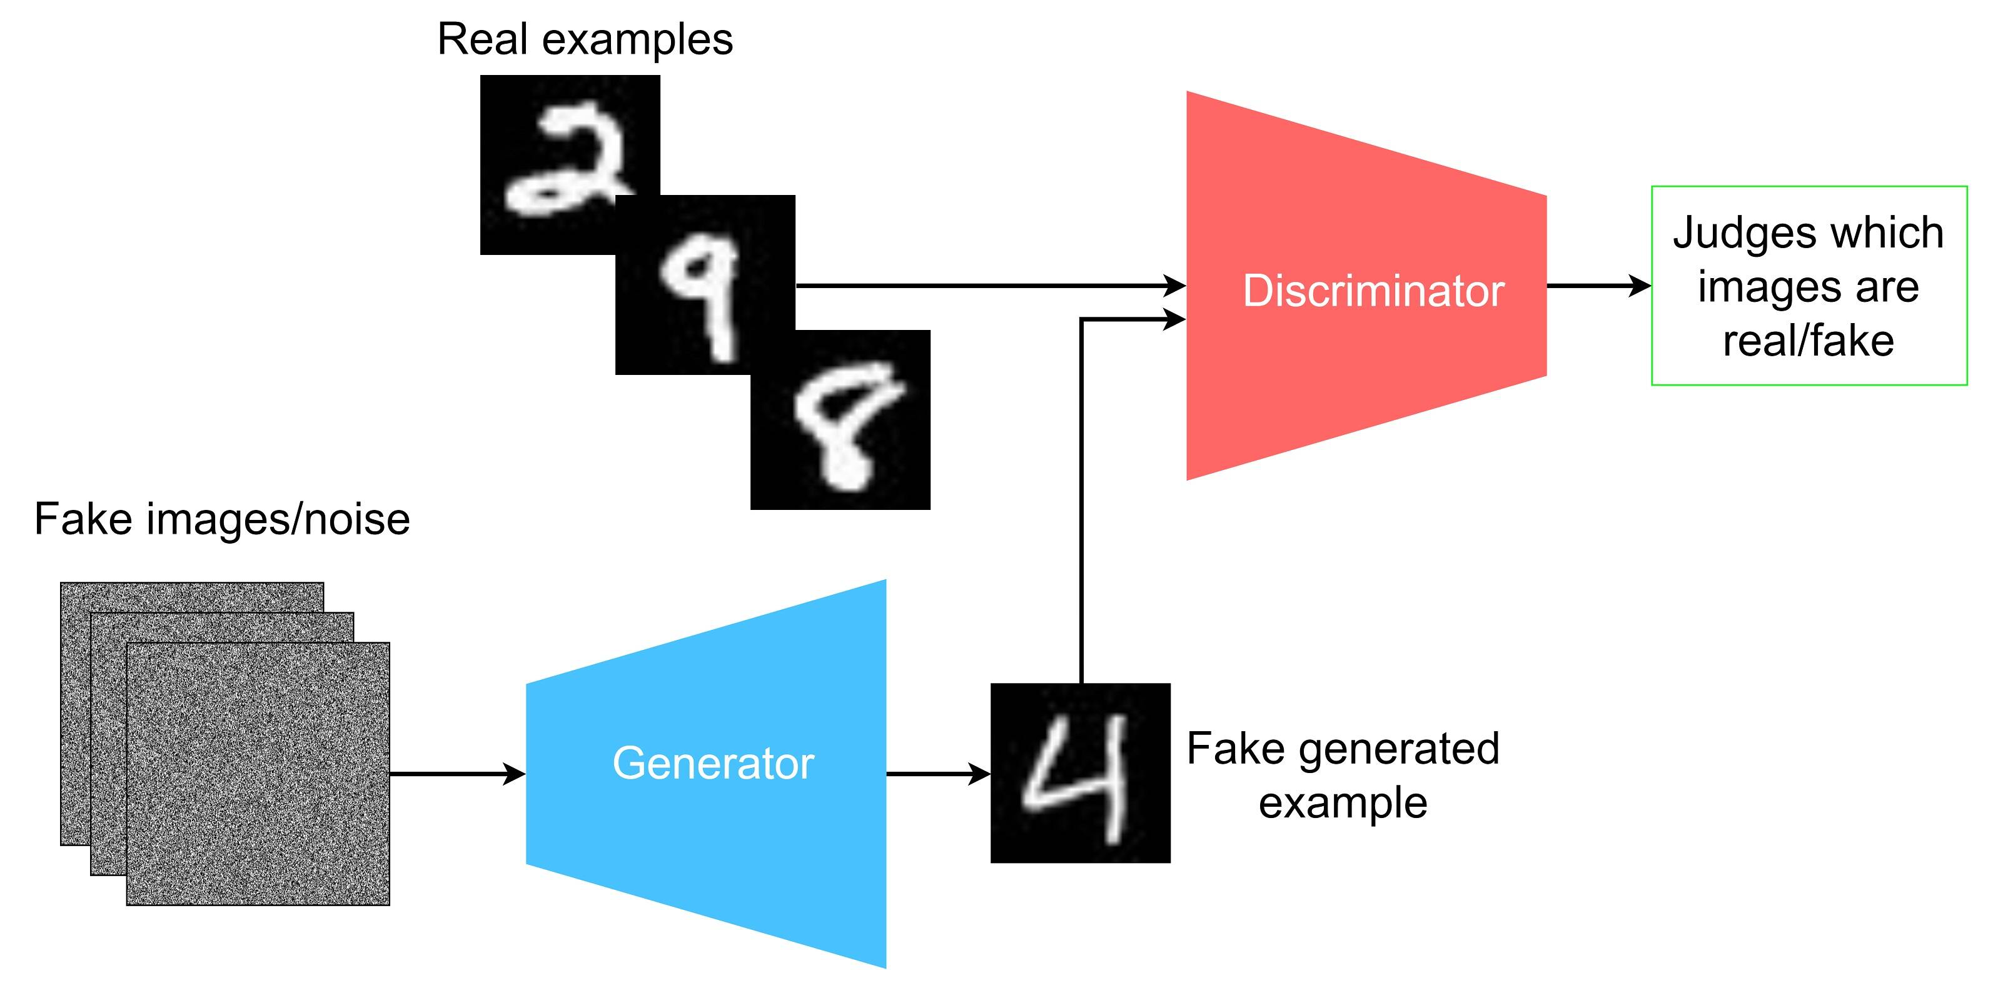
Modern DL Model Architectures
6
Generative Adversarial Networks (GANs)
Key Features: Comprises two neural networks, a generator and a discriminator, competing against each other.
Mechanism:
Generator creates images, trying to fool the discriminator by generating data similar to those in the training set.
Discriminator evaluates them, trying to distinguish between fake data and real data
Example Models: DCGAN, Pix2Pix, CycleGAN.
Figure. Visualization of the flow of GAN
Applications in Biomedicine:
Generate high-resolution images from low-resolution inputs, enabling improved image quality.
Data augmentation in medical imaging for robust model training.
Notes:
Ref: https://developer.ibm.com/articles/generative-adversarial-networks-explained/

Slide 34

Modern DL Model Architectures
7
Transformer Models
Key Features: Utilizes self-attention mechanisms, excellent for handling sequences of data.
Key Innovation: Following an encoder-decoder structure, eliminating recurrence and convolutions.
Example Models: BERT (adapted for biomedical applications), AlphaFold.
Applications in Biomedicine:
Genomic sequence analysis for personalized medicine.
Protein structure prediction (e.g., AlphaFold's breakthroughs).
Figure. Transformer architecture
Notes:
Ref: https://machinelearningmastery.com/the-transformer-model/

Slide 35
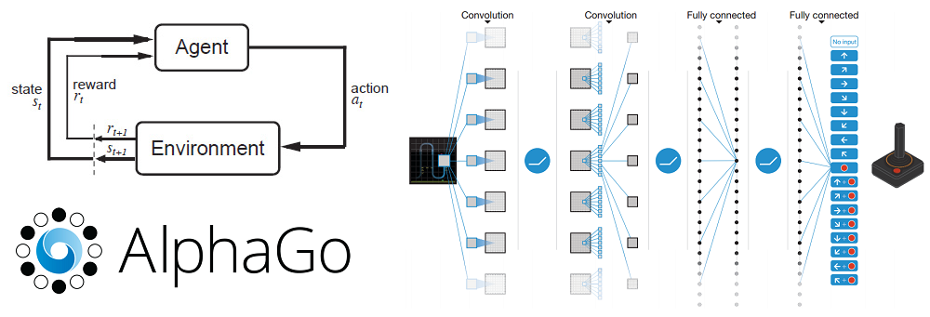
Modern DL Model Architectures
8
Deep Reinforcement Learning
Key Features: DRL leverages neural networks to approximate value functions and policies, enabling agents to learn complex tasks from high-dimensional sensory inputs.
Key Components: Agent, Environment, Reward, Policy, and Value Function.
Example Models: DQN (Deep Q-Network), A3C (Asynchronous Advantage Actor-Critic), PPO (Proximal Policy Optimization) ,SAC (Soft Actor-Critic)
Applications:
Game Playing; Robotics
Autonomous Vehicles; Healthcare
Notes:
Ref: https://machinelearningmastery.com/the-transformer-model/

Slide 36
Types of Deep Learning
Deep Learning
Unsupervised Learning
The neural network learns to discover the patterns or to cluster the dataset based on unlabeled datasets. There are no target variables.
Generative Model
DDPG
CNN
…
Autoencoders
Supervised Learning
An agent learns to make decisions in an environment to maximize a reward signal. The agent interacts with the environment by taking action and observing the resulting rewards.
Reinforcement Learning
…
RNN
…
Neural network learns to make predictions or classify data based on the labeled datasets.
Deep Q Network

Slide 37
Content
1 Applications of deep learning
2 Deep learning basics
3 Deep learning model structures
4 Training deep learning models
5 Deep learning theory

Slide 38



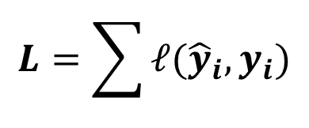

Fitting DL Models
$${\hat{y}}_{1}$$
$$y_{1}$$
Design the neural network
$$X_{1}$$
Find a criterion/measurement of goodness
Get the best model for the problem
Designed
Neural Network
$$X_{2}$$
$${\hat{y}}_{2}$$
$$y_{2}$$
……
……
……
$$X_{n}$$
$${\hat{y}}_{n}$$
$$y_{n}$$
A loss function is needed here,
to measure the difference between the output and truth
Total loss:
$$L=\sum{ℓ({\hat{y}}_{i},y_{i})}$$
Find the network parameters to minimize the loss

Slide 39
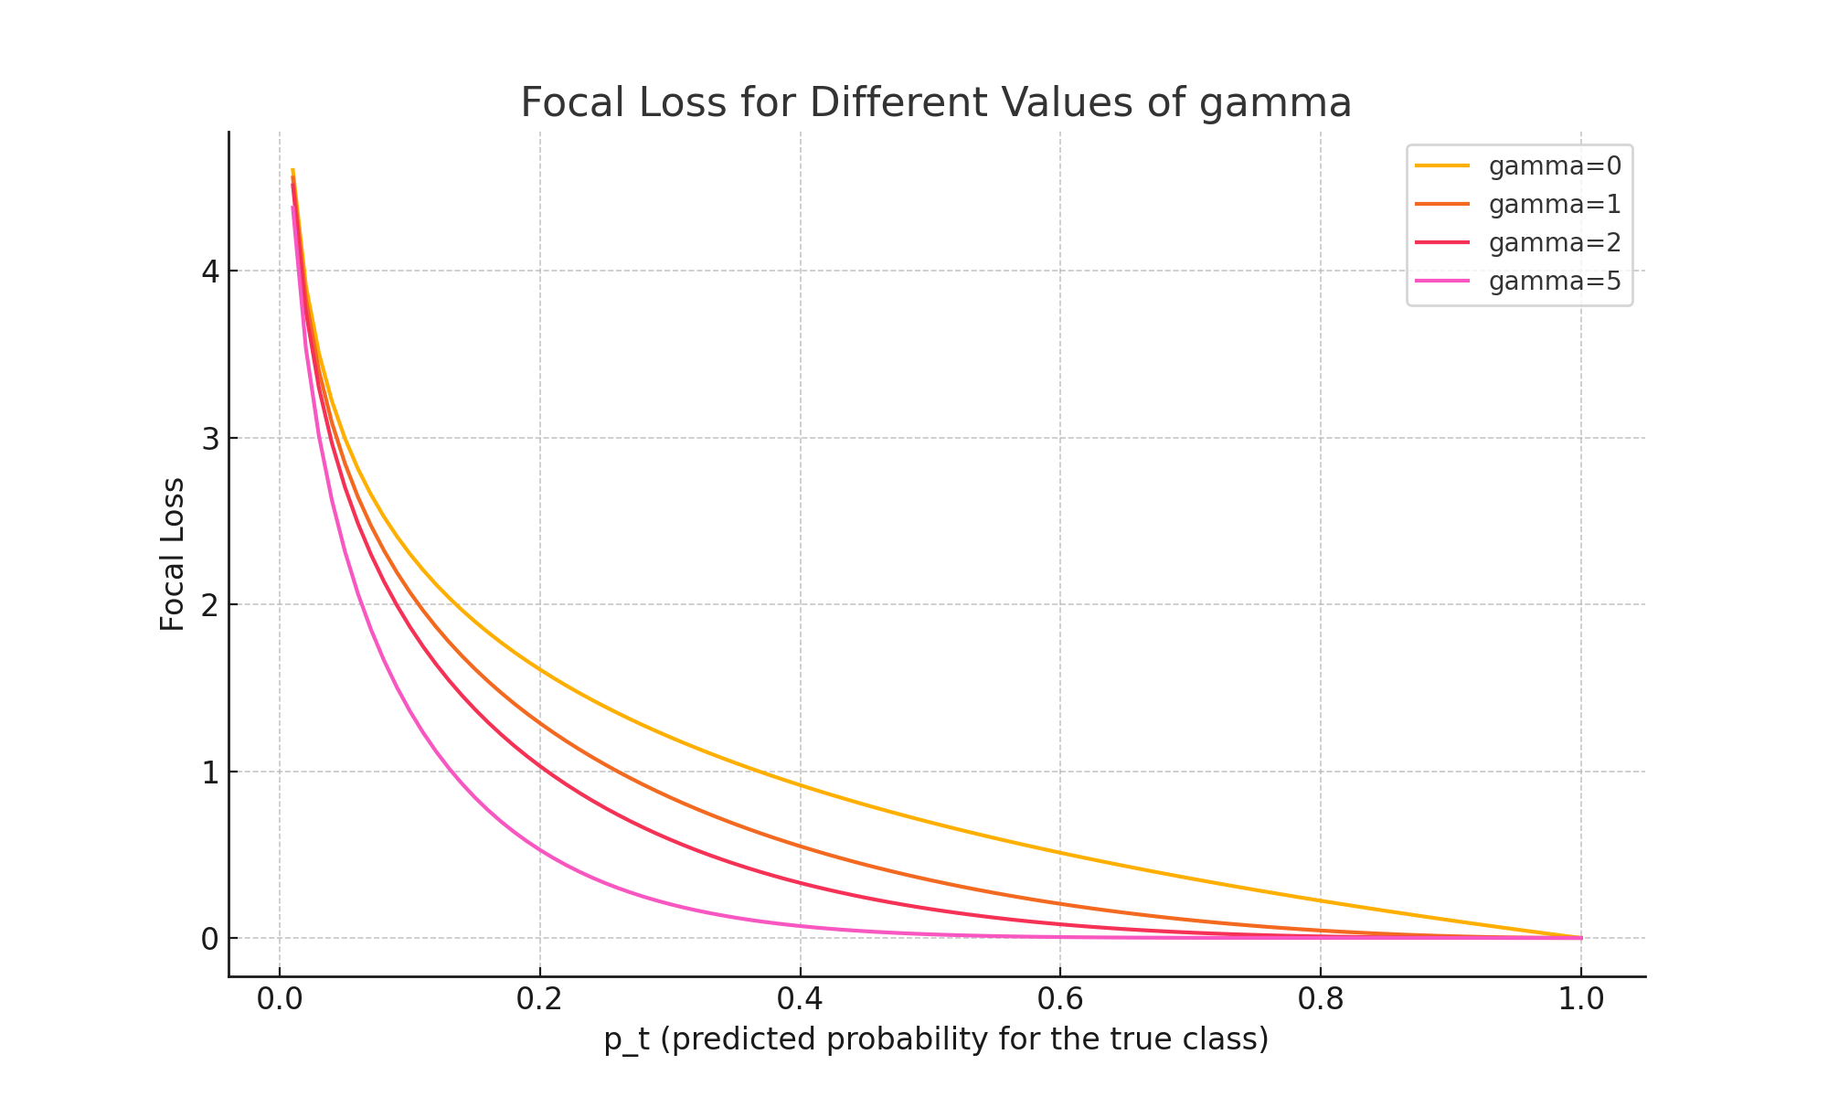
Loss Functions
Understand Your Problem:
Classification vs. Regression:
Use Cross-Entropy for classification.
Use Mean Squared Error (negative log-likelihood function) for regression.
Consider Data Characteristics:
Imbalanced Data: Use Weighted Cross-Entropy or Focal Loss.
Outliers: Use Huber Loss or Mean Absolute Error.

Slide 40
Gradient Descent
A first-order iterative optimization algorithm for finding the minimum of a function.
Hopefully we can find the right path to get the lowest point
When consider multiple variables,
Local minima
Gradient descent cannot guarantee global minima.

Slide 41
Stochastic Gradient Descent
Batch SGD
Adaptive Moment Estimation (Adam)
Momentum
Backpropagation algorithm
Forward Pass
Backward Passes

Slide 42
Backpropagation Algorithm

Slide 43
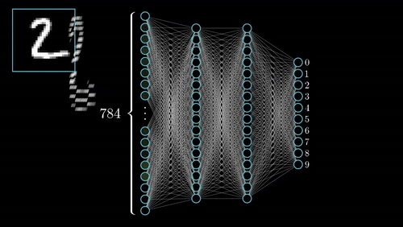
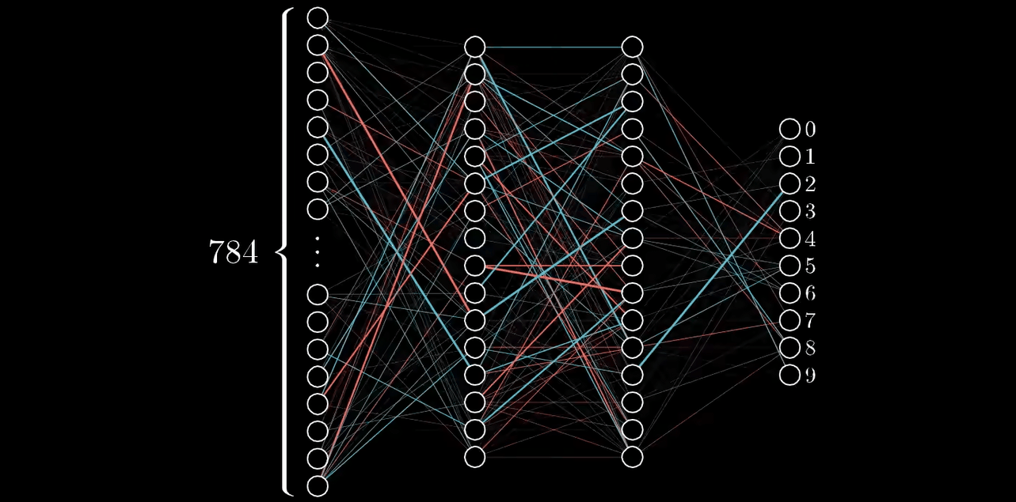
Backpropagation Algorithm
2 Steps:
Forward Propagation
1. Forward Propagation
Forward propagation is how neural networks make predictions.
Involves passing input data through the network layer by layer to the output.
2. Backpropagation
Backpropagation is the process of adjusting the weights of the network by propagating through the neural network backward.
Involves calculating the gradient of the loss function with respect to each weight by the chain rule.
The weights are adjusted in the direction that reduces the loss.
Backpropagation
Both steps are iteratively repeated for several epochs to minimize the loss and improve the model's accuracy.
Notes:
Figure 1: https://www.google.com/url?sa=i&url=https%3A%2F%2Fpurnasai.github.io%2FA-Beginner-Intro-to-Neural-Networks%2F&psig=AOvVaw052h0mPMCkBhbycfkkrFPy&ust=1705182098053000&source=images&cd=vfe&opi=89978449&ved=0CBIQjRxqFwoTCMDbvr7o2IMDFQAAAAAdAAAAABBN
Figure 2: https://pub.towardsai.net/backpropagation-2eeb25201095?gi=98cad22856a1

Slide 44
Regularization Methods
Four Mechanisms:
Make the modeled function smoother.
Increase the effective amount of data.
Combine multiple models to mitigate uncertainty in the fitting process.
Encourages the training process to converge to a wide minimum, where small errors in the estimated parameters are less important.

Slide 45
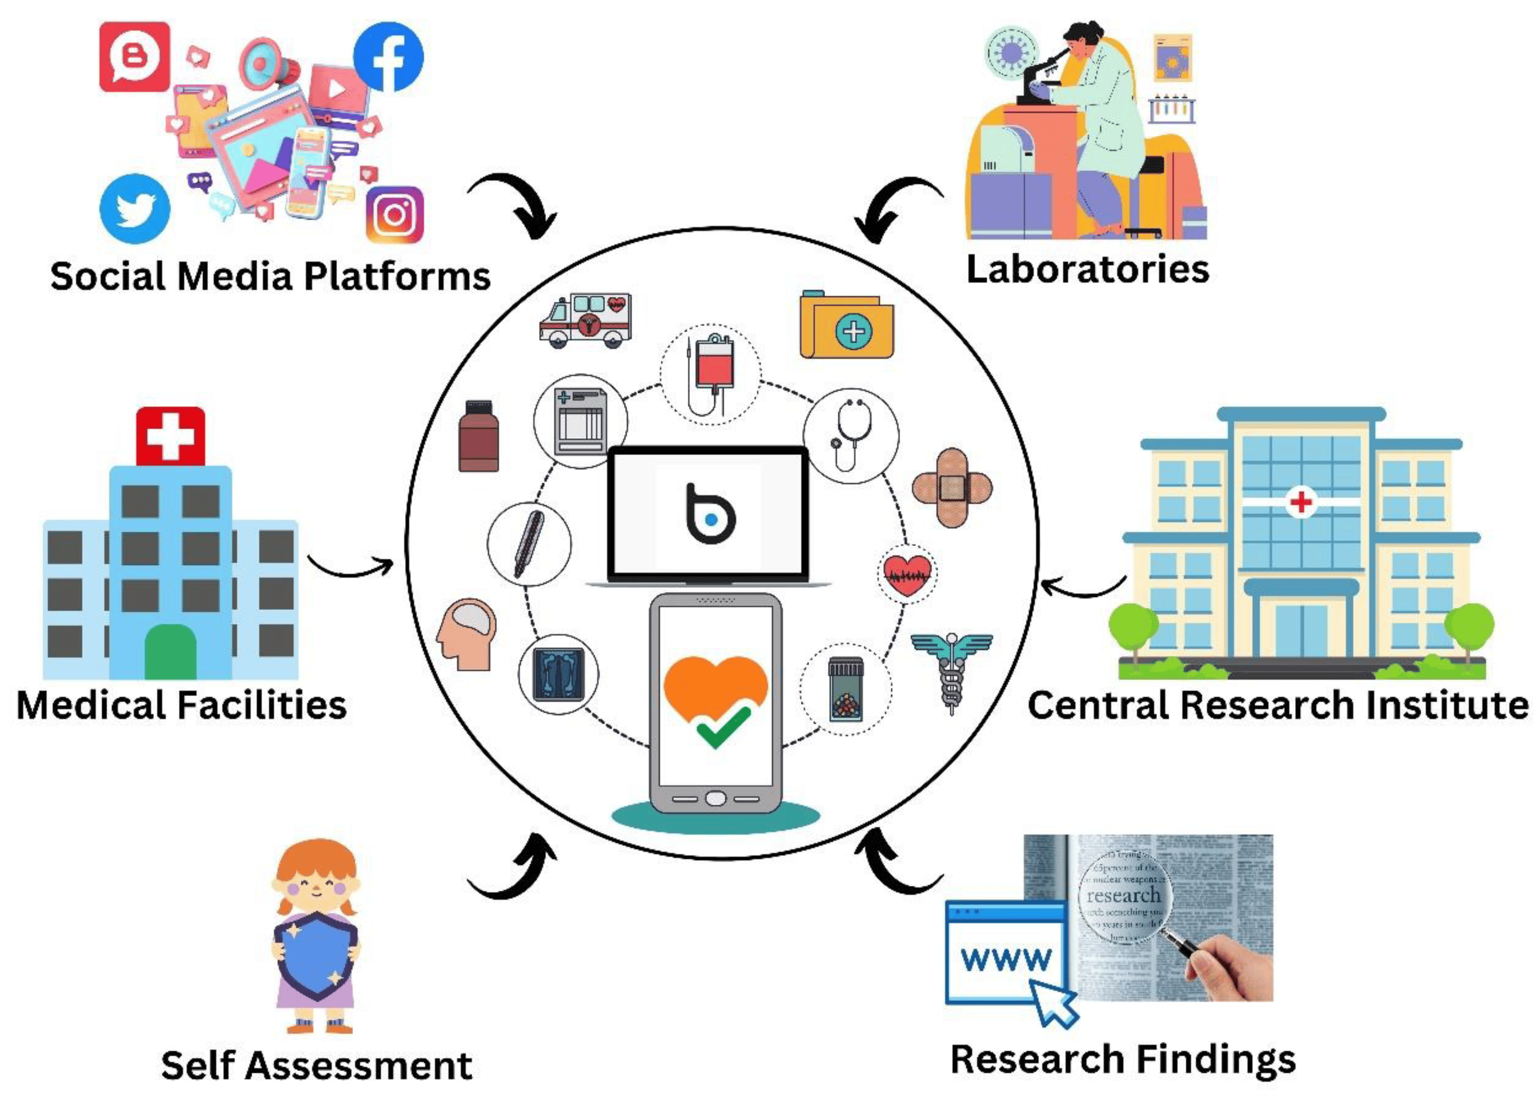
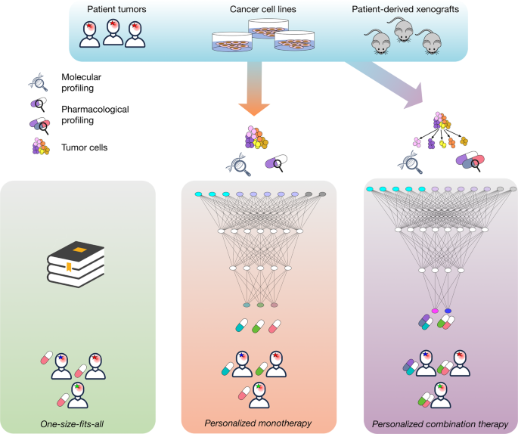
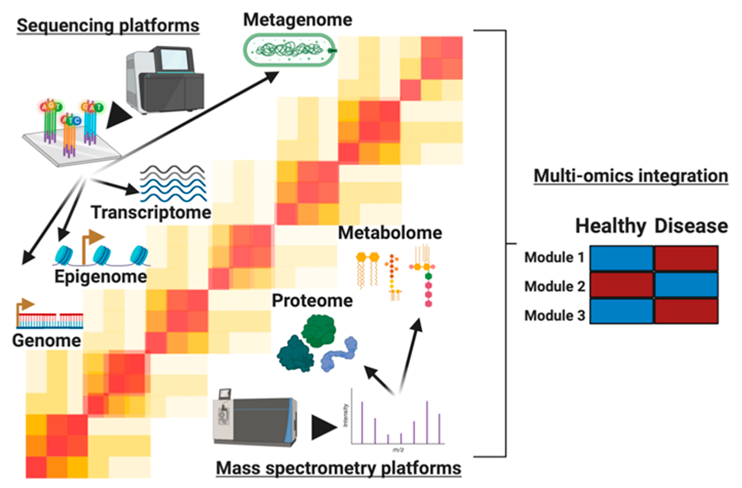
Some Future Directions in DL for Biostatistics
AI-driven Public Health Interventions
Advanced Drug Response Modeling
Integrative Analysis of Multi-omic Data
Utilizing deep learning models to analyze large-scale public health data for informed decision-making and policy development. Allowing better resource allocation, and more effective epidemic control strategies.
Using deep learning to model and predict individual responses to drugs, considering genetic, environmental, and lifestyle factors. Developing more effective personalized treatments.
Leveraging deep learning to integrate and analyze data from genomics, proteomics, metabolomics, and other omics fields for a comprehensive understanding of biological processes and disease mechanisms.
Notes:
Figure 1 ref: https://www.mdpi.com/2076-393X/11/7/1154
Figure 2 ref: https://www.nature.com/articles/s41698-020-0122-1
Figure 3 ref: https://www.mdpi.com/2218-273X/10/12/1606

Slide 46










Workflow of a Typical Deep Learning Project
Data Preprocessing
Training Dataset
Modeling
Cleaning Data
60% ~ 80%
Define model architecture and hyperparameter
Scaling Numeric Features
Validation Dataset
Data Acquisition
20%~10%
Public Datasets
Databases
Web-scraping
Crowd Labeling
Test Dataset
Handling Categorical Data & text
20%~10%
Splitting Data
Understand Problem
Train on training dataset
Hyperparameter Tuning
Unsatisfactory
Tune hyperparameters
Tweak architecture
Add regularization
Study why the model is struggling
Model Evaluation
Deployment
Acceptable
Notes:
https://www.codecademy.com/article/deep-learning-workflow

Slide 47







Face Recognition System
Image
Acquisition
Face Recognition
Model Training
Face Detection
Camera
Feature Extraction
Gabor, LBP etc.
Iphone
Face Matching
Deep Learning
Recognition
Results
Monitor
Videos

Slide 48
Content
1 Applications of deep learning
2 Deep learning basics
3 Modern deep learning structures
4 Training deep learning models
5 Deep learning theory

Slide 49
Statistical Theory of Deep Learning
Approximation theory viewpoint
Recently, a large collection of works bridge approximation theory of neural network models with empirical processes.
Applications: Fast convergence rates of excess risks in regression and classification tasks.
Perspectives: Measuring complexities of neural networks for function approximations.
Scaling Parameters: Network width, depth, and active parameters should scale with sample size, data dimension, and function smoothness index.
Assumptions:
Assumes global minimizers of loss functions are obtainable.
Focuses on statistical properties without optimization concerns.
Recognizes non-convexity of loss functions due to non-linear activation functions.
Training Dynamics Viewpoint
Understanding non-convex loss functions for neural network models is crucial. Key implications for generalization capabilities.
Key Empirical Findings: Overparameterized neural networks trained by stochastic gradient descent can fit noisy data or random noise perfectly but still generalize well.
Overparameterization Insights:
The dynamics of deep neural networks with large enough width, trained via gradient descent (GD) in ℓ2-loss, behave similarly to those of functions in reproducing kernel Hilbert spaces (RKHS),where the kernel is associated with a specific network architecture.
In the Mean-Field (MF) regime, the network parameters have the flexibility to deviate significantly from their initial values, even though it necessitates an infinite width.
Comprehensive understanding of weight initializations and learning rate scalings in gradient-based methods.

Slide 50
Deep learning theory
Data
Model
Assumption
Ideal
Estimate
The Risk Error
Approx Error
Complexity
~ p(x)p(y|x)

Slide 51
Functional Equivalence can reduce stochastic and optimization errors

Slide 52

Deep learning theory
Existing results cannot explain why deep and/or reinforcement learning methods work in realistic scenarios.
Existing mathematical and statistical theory is not good enough to delineate many algorithmic modelling.
Many breakthroughs in algorithmic modeling do not have any mathematical reasoning.

Slide 53
References
Belkin, M., Hsu, D., Ma, S., & Mandal, S. (2019). Reconciling modern machine learning practice and the bias-variance trade-off. arXiv preprint arXiv:1812.11118.
Hamilton, W. L. (2020). Graph Representation Learning. McGill University.
Kaplan, J., McCandlish, S., Henighan, T., Brown, T. B., Chess, B., Child, R., ... & Amodei, D. (2020). Scaling laws for neural language models. arXiv preprint arXiv:2001.08361.
Nagarajan, V., & Kolter, J. Z. (2019). Uniform convergence may be unable to explain generalization in deep learning. Advances in Neural Information Processing Systems, 32.
Prince, S. J. D. (2023). Understanding Deep Learning.
Recent Advances in the Generalization Theory of Neural Networks – ICML2023 Tutorial.
Shen, G. (2024). Exploring the Complexity of Deep Neural Networks through Functional Equivalence. International Conference on Machine Learning 2024
Suh, N. and Cheng, G. (2024). A Survey on Statistical Theory of Deep Learning: Approximation, Training Dynamics, and Generative Models
Understanding the Double Descent Phenomenon in Deep Learning.

Slide 54
Class Schedule
Morning Session
Introduction to Deep Learning (Hongtu Zhu)
Introduction to Deep Learning Packages/resources (Runpeng Dai)
Deep Generative Models (Xiao Wang)
Afternoon Session
Transformer and self-supervised learning (Xiao Wang)
Survival Analysis with Deep Learning and Deep Quantile Regression (Hongtu Zhu)
Time Series and Spatial-Temporal Data Modeling (Runpeng Dai)
Notes:
Change the specific schedule

Slide 55





How to succeed in this course?
Visualize
Practice
Explore
Discuss
Ask

